Slide 1

Presented By:- Amarnath Kommineni Kavya Gurram Sandeep Borwal Vikas Kumar Reddy Buchammagari
Course :- DSCI 8950 Presented To:- Lochana Palayangoda
Predicting Housing Market Trends: A Data-Driven Approach to Price Forecasting

Slide 2
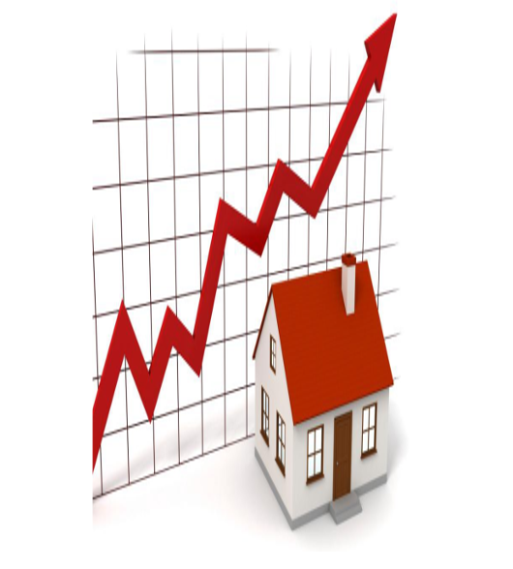
Problem Statement
How accurately can we predict housing prices using machine learning models based on property features and market conditions, and which factors matter most?
Notes:
Introduction
The real estate market significantly impacts the global economy.
Housing prices depend on multiple factors like location, size, and market trends.
Traditional pricing methods are subjective, time-consuming, and prone to errors.
Problem Statement
Estimating property values accurately remains a challenge.
Current appraisal methods lack efficiency and objectivity.
Solution: Machine Learning Model
Leverages historical data to identify patterns and correlations.
Improves accuracy by reducing human bias in price estimation.
Provides quick, data-driven predictions based on market conditions.
Project Goal
Develop a machine learning model to predict housing prices.
Use key property attributes and economic indicators for training.
Enhance reliability and efficiency in real estate pricing.

Slide 3
Machine Learning Workflow: Current Stage
Data Collection & Cleaning: Gather property data from sources.
Exploratory Data Analysis (EDA): Identify trends and correlations.
Model Development: Train various ML models (regression, ensemble methods, deep learning).
Finalize Model,
Report
Identify best model , refine model , retrain models
Model Evaluation & Optimization: Use RMSE, MAE, and R-squared to assess accuracy.
Notes:
Data Collection & Cleaning – Gather data from different sources & cleanse data for processing
Exploratory Data Analysis – Understand the data and identify relationship
Model Development: Identify the models to use and Train various ML models and get the accuracy
Model Evaluation & Optimization:-Evaluate the model and optimize parameters
Identify best model , refine model , retrain model
Finalize Model,Report

Slide 4
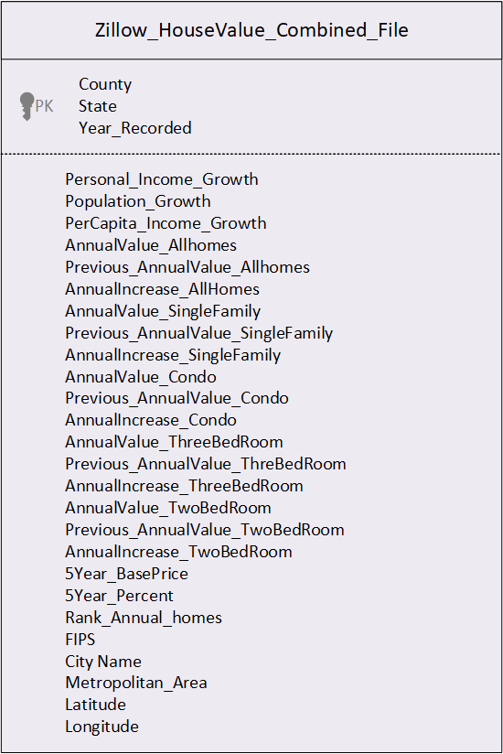
Zillow House Price Model Dataset
Exploratory Data Analysis(EDA)
Notes:
As part of Exploratory Data Analysis ; we read the Zillow Home Value Index data sets for AllHomes, Single Family , Condo, TwoBedRoom, ThreeBedRoom .
Build Annual Increase for each of County for each Year.
Build 5 Year Increase for each of County for each Year.
Idnetified Personal income Growth , Population Growth , Percapita Income Growth for each county to every year . Performed Percapita Increase from year to Year.
Build Rank for each County and performed Exploratory Data Analysis and produced Combined Dataset.

Slide 5
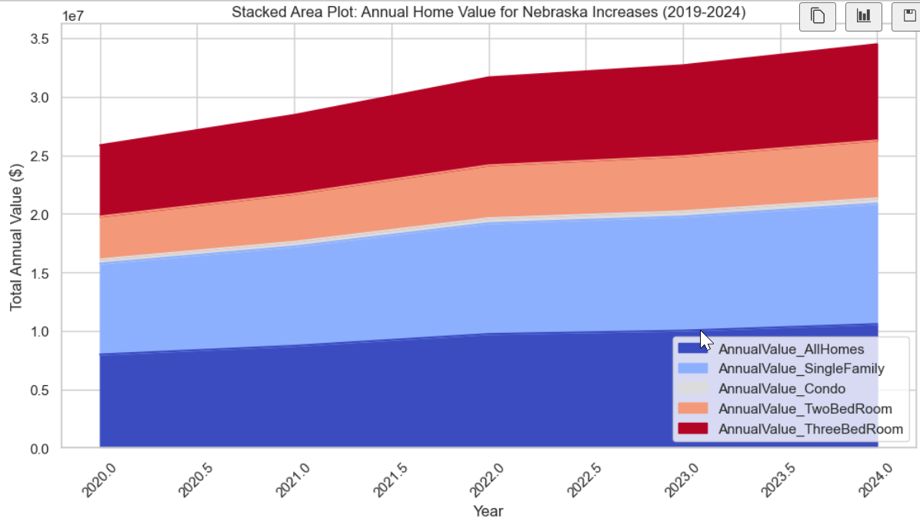
EDA with House Values across all Categories over Years

Slide 6
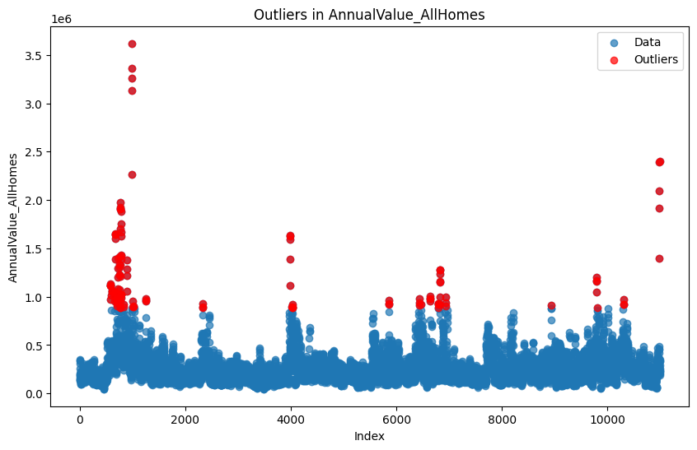
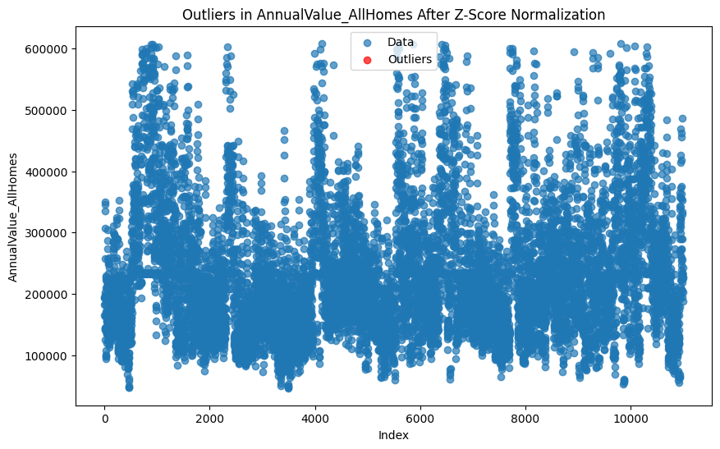
Identify and Replace Outliers
Notes:
Identify the outliers in the data. Outliers are determined using the Interquartile Range (IQR) of house values. The IQR is calculated between the 25th percentile (Q1) and the 75th percentile (Q3) of the data.
Outliers are defined as values falling outside the lower and upper bounds:
Lower bound = Q1 - 1.5 * IQR
Upper bound = Q3 + 1.5 * IQR
Here, 1.5 is a commonly used multiplier in the outlier detection process and is known as the "outlier coefficient." It is applied to the IQR to define the threshold beyond which data points are considered outliers.
Remove Outliers using Z-Score Normalization . Calculate Z-Score and replace with mean on Z-Scores > 2 and < -2 .

Slide 7

Steps Involved
Impute the missing Data
Build Machine Learning Models
Evaluate the Results
Notes:
Impute the missing Data - For Few Years on some of the counties ; we do not have Population Growth, Personal Income Growth , Percapita Income Growth , Previous Annual Values .
If the data is available in the subsequent year for the same county, the missing value will be imputed as 90% of the value to populate for the current year.
If no data is available in the subsequent year, the missing value will be imputed as the mean value for the respective State and County combination.
Identify and Remove Outliers in the Data
Build Machine Learning Models
Build Machine Learning Models using Percapita, Population Growth , Personal Income Growth, Previous Annual Value, Annual Value, Annual Percent Increase for each Year.Build Train and Test Data. Train Data will be used for all other Years other than 2024 data. Test Data set will be used with 2024 Year and mark it as for Year 2025.
Convert Categorical Features to Numeric using one-hot encoding .
Perform Cross Fold Validations
- Limited categorical variables affecting regional property insights.
- Gaps in time-series data requiring interpolation.
- Aggregation mismatches between county-level and zip-code-level data.
Evaluate the Results
Identify RMSE , MAE, Train Accuracy , Test Accuracy for each Model Output.
Based on the results identify best Model will be output.
Identify Features that has Highest Importance.

Slide 8
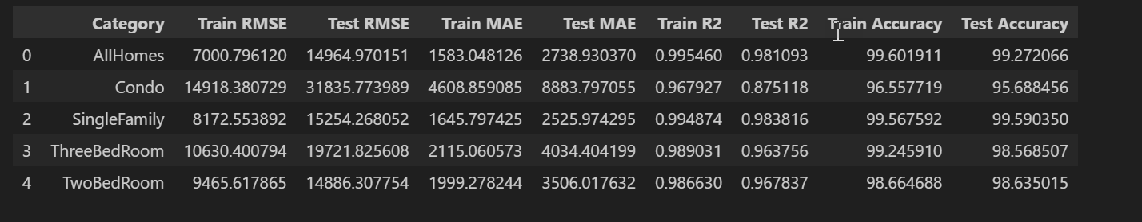
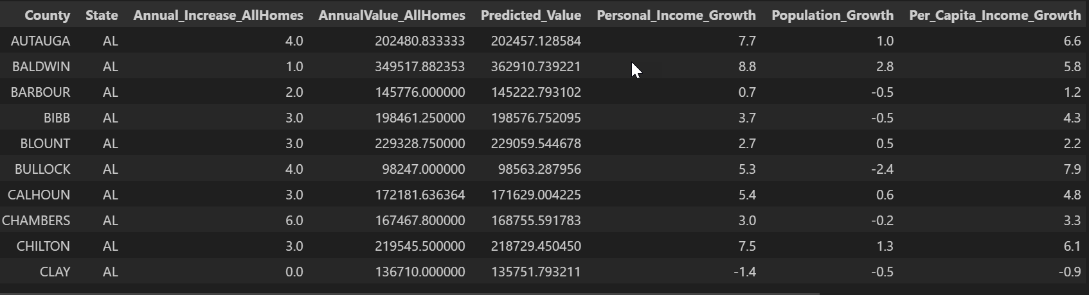
Random Forest
For real estate prediction, Random Forest excels at modeling complex non-linear relationships between features, handling interactions between location and economic indicators, managing outliers in housing data, and capturing both local and regional market trends.
Key Findings:
Very high accuracy across all property categories (95-99%)
Excellent R² values (0.87-0.98) indicating strong predictive power
Performance is particularly strong for SingleFamily homes
The model effectively handles different property types with varied characteristics
Test Metrics
Notes:
Random Forest for Regression uses Random Forest Regressor

Slide 9
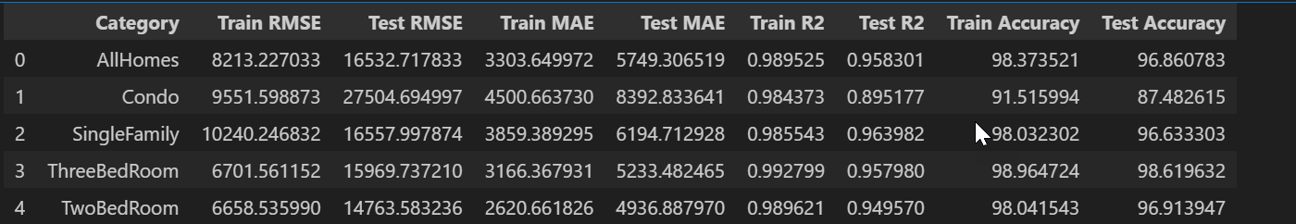
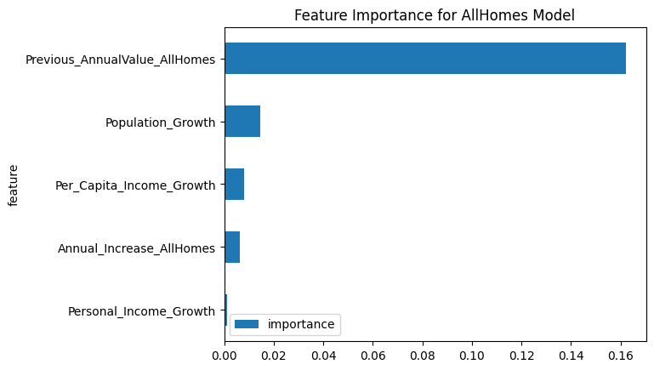
XGBOOST
XGBoost (Extreme Gradient Boosting) is a powerful machine learning algorithm that is part of the gradient boosting family. XGBoost builds an ensemble of decision trees, where each new tree corrects the errors made by the previous trees.
XGBoost has various hyperparameters (e.g., learning rate, number of estimators, maximum depth, etc.) that are fine-tuned to improve model performance. This allows it to fit the house price prediction model optimally.
Notes:
subsample=0.8: Uses 80% of the training data for each tree to reduce overfitting.
n_estimators=100: Builds 100 trees (or boosting rounds) in the model.
max_depth=6: Sets the maximum depth of each tree to 6 levels, balancing model complexity.
learning_rate=0.1: Controls how much each tree influences the model, with smaller values requiring more trees.
gamma=0: No additional regularization is applied to the tree-building process.
colsample_bytree=0.8: Uses 80% of the features to build each tree, helping to prevent overfitting.
random_state=42: Ensures reproducibility of results.

Slide 10
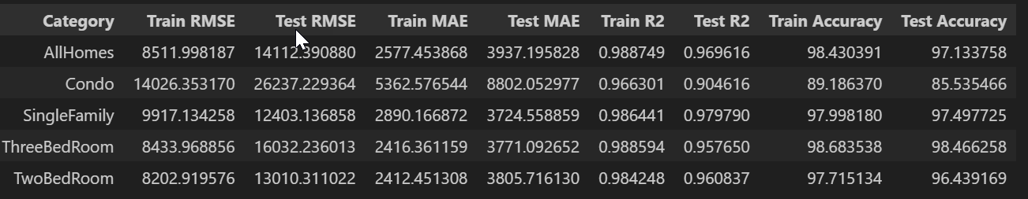
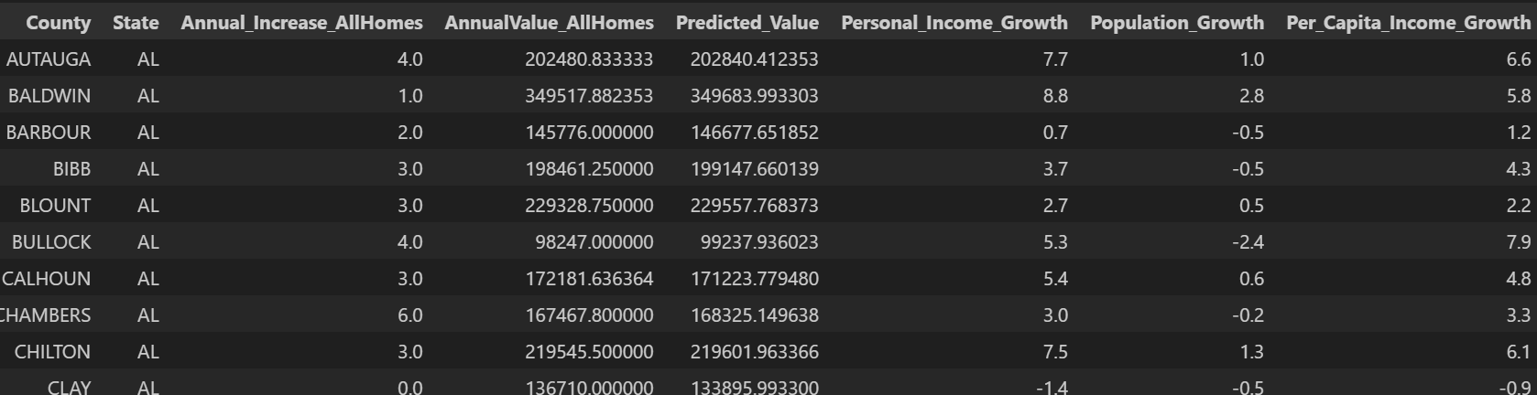
Light Boost
LGBM (Light Gradient Boosting Machine) –
LGBM (Light Gradient Boosting Machine) is a powerful machine learning algorithm in the gradient boosting family, similar to XGBoost.
It builds an ensemble of decision trees iteratively, where each tree corrects errors from the previous one.
Unlike XGBoost, which uses depth-first growth, LightGBM grows trees leaf-wise, selecting the leaf with the highest loss reduction.
LightGBM natively handles categorical features, unlike XGBoost, which requires manual encoding.
Notes:
subsample=0.8: Uses 80% of the training data for each tree to reduce overfitting.
n_estimators=100: Builds 100 trees (or boosting rounds) in the model.
max_depth=6: Sets the maximum depth of each tree to 6 levels, balancing model complexity.
learning_rate=0.1: Controls how much each tree influences the model, with smaller values requiring more trees.
gamma=0: No additional regularization is applied to the tree-building process.
colsample_bytree=0.8: Uses 80% of the features to build each tree, helping to prevent overfitting.
random_state=42: Ensures reproducibility of results.

Slide 11
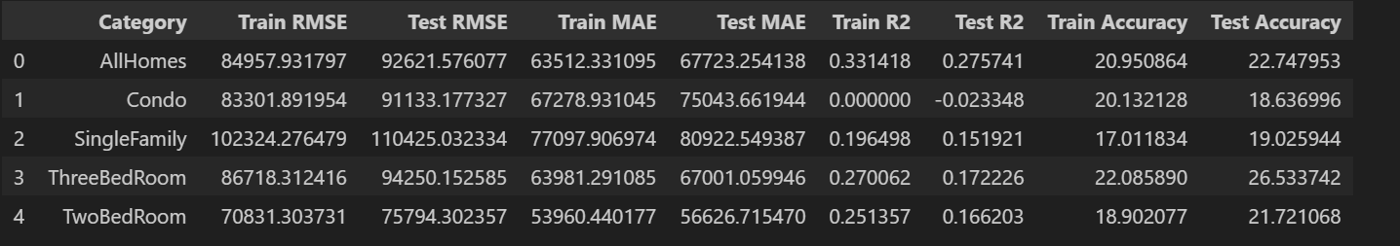
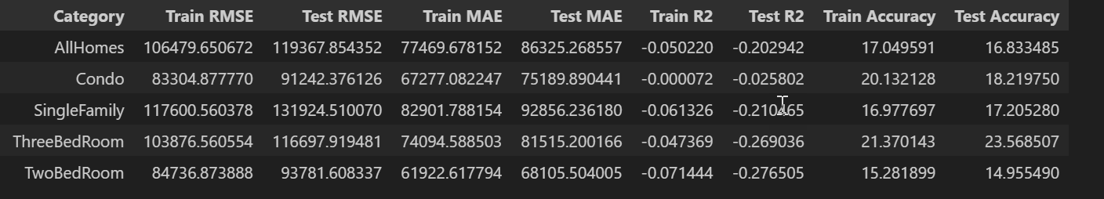
Lasso and SVR
Lasso Results
LASSO performs both feature selection and regularization in order to enhance the prediction accuracy and interpretability of the resulting model.
Support Vector Regression (SVR) is a machine learning technique used for regression tasks. It is a variant of Support Vector Machines (SVM) and is designed to predict continuous numeric values.
SVR Results
Notes:
lgbm_model = LGBMRegressor(
subsample=0.8,
n_estimators=100,
max_depth=6,
learning_rate=0.1,
random_state=42
)
we can see the model performance metrics for both Lasso and SVR across different housing categories.
Lasso, which stands for Least Absolute Shrinkage and Selection Operator, it's both selecting important features and applying regularization. This helps us improve prediction accuracy while keeping our model interpretable.
The regularization technique it uses is really interesting - it adds a penalty term to the objective function during training, which prevents overfitting and improves how well our model generalizes to new data.
Specifically, Lasso uses L1 regularization, which shrinks less important coefficients all the way to zero. This effectively removes those variables from the model, giving us a simpler, more focused prediction tool. You can see in our results table how this affects performance across different housing categories.
Now looking at the bottom half, Support Vector Regression is a completely different approach. SVR comes from the Support Vector Machine family but is designed specifically for regression tasks. It works by finding a function that predicts continuous values while maintaining a "margin" around the prediction line. The goal is to fit within this margin while minimizing prediction error.
The performance metrics show interesting patterns across our different housing categories - from condos to single-family homes.

Slide 12
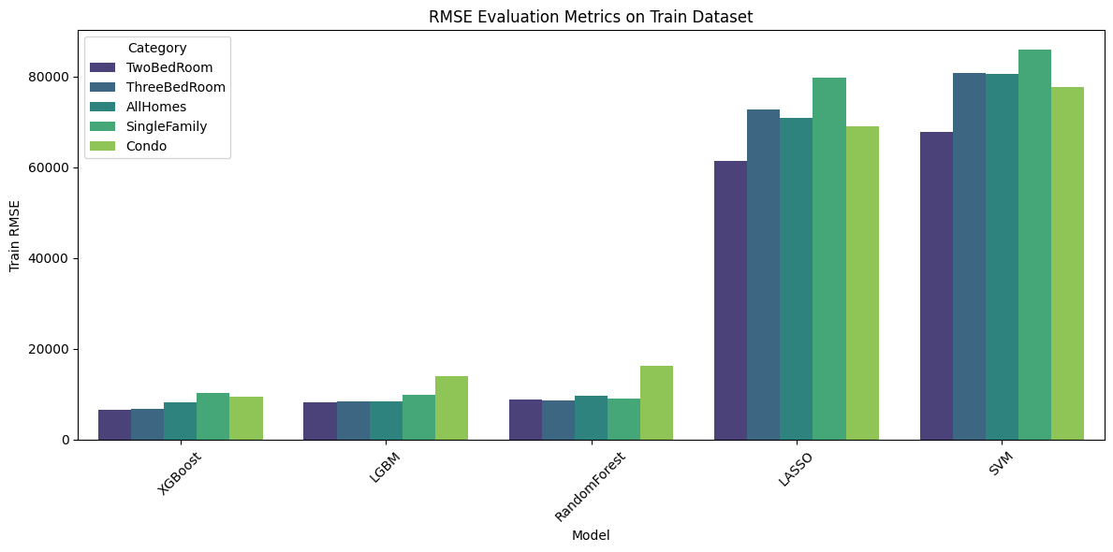
Model Evaluation on Train Data
Notes:
This graph really tells a story about model performance during training. The RMSE (Root Mean Square Error) values show us how accurately each model is predicting housing prices across different categories.
What immediately jumps out is how XGBoost, LGBM, and RandomForest are performing exceptionally well during training - their RMSE values are consistently low across all housing categories. This suggests they're fitting the training data very effectively.
In contrast, look at Lasso and SVM! Their RMSE values are significantly higher - often 5-10 times higher than the other models. This substantial difference indicates these models aren't capturing the patterns in our training data as thoroughly.
The housing categories also show interesting patterns. Two-bedroom properties seem to be easier to predict for most models compared to Single Family homes, which show higher error rates across all algorithms.

Slide 13
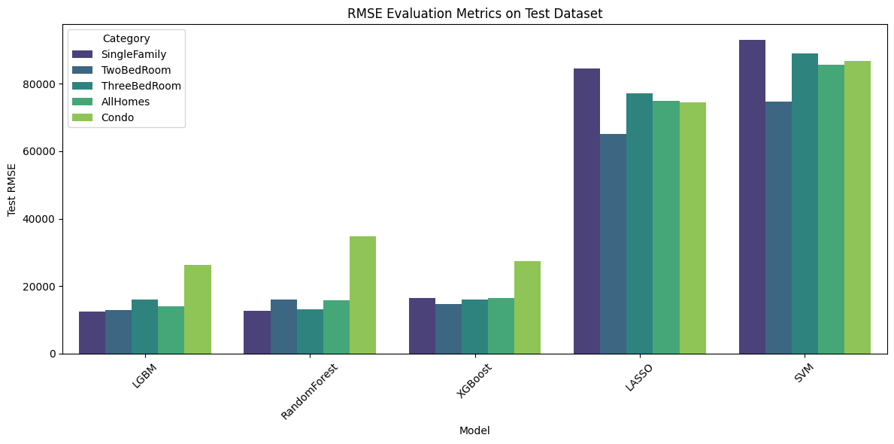
Model Evaluation on Test Data
Notes:
Now here's where things get really interesting - how do these models perform on data they haven't seen before? This is the true test of generalization.
The pattern we saw in training largely holds true for testing. XGBoost, LGBM, and RandomForest continue to show strong performance with low RMSE values, especially for Single Family and Two-Bedroom properties.
Lasso and SVM still show significantly higher error rates, but notice something important - the gap between their training and testing performance is actually smaller than for some of the other models. This suggests that while they don't fit the data as closely, they're not overfitting either.
The Condo category consistently shows higher error rates across all models. This might indicate that condo pricing is more complex or volatile than other housing types, making it inherently harder to predict accurately.

Slide 14
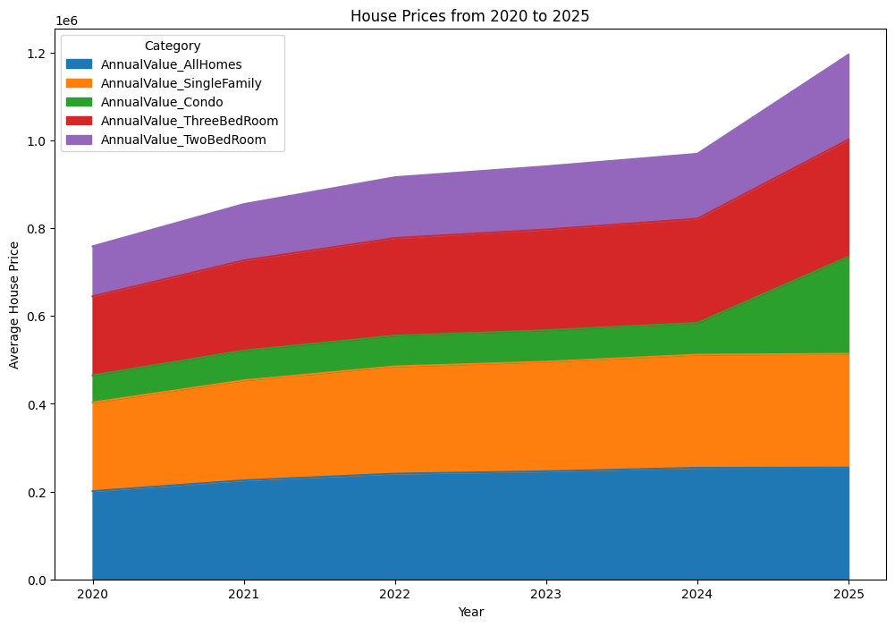
Predictions including 2020 to 2025 across all categories
Notes:
shows the projected housing prices from 2020 to 2025 across all categories. This stacked area chart gives us a comprehensive view of how different property types contribute to the overall market.
What's fascinating here is the acceleration we see around 2024-2025, where prices appear to increase at a faster rate than the more gradual growth from 2020-2023. Two-bedroom properties (shown in purple at the top) show particularly strong growth projections.
Single-family homes maintain the largest portion of the market value throughout the period, as shown by the substantial orange section. Meanwhile, condos (in green) show steady but more modest growth compared to other categories.
The overall upward trajectory across all categories suggests our models are predicting continued strength in the housing market through 2025, with the average price reaching approximately $1.2 million by the end of our projection period.

Slide 15
Conclusion
Dataset Preprocessed
Machine Learning Models Implemented
Key Findings
Machine learning significantly improves housing price predictions compared to traditional methods.
XGBoost outperformed other models, handling non-linear relationships effectively and managing missing values without imputation.
Notes:
Overview of the Project
Predict housing market prices using machine learning techniques.
Traditional property valuation methods are often inefficient and subjective.
Dataset Preprocessing:
Handling missing values using imputation techniques.
Identifying and removing outliers using IQR and Z-score normalization.
Encoding categorical features for model compatibility.
Machine Learning Models Implemented:-
XGBoost (Extreme Gradient Boosting) LightGBM (Light Gradient Boosting Machine)
Lasso Regression Support Vector Regression (SVR)
Model performance was evaluated using RMSE, MAE, and accuracy scores.
Key Findings
Machine learning significantly improves housing price predictions compared to traditional methods.
XGBoost outperformed other models, handling non-linear relationships effectively and managing missing values without imputation.
Implications
The model provides a more objective and data-driven approach to property valuation.
Helps real estate professionals, investors, and policymakers make better decisions based on market conditions.

Slide 16
Future Work
Revisit
Revisit to Identify the Best Model, Refine Model, and Retrain Models
Test
Test XGBoost with Error as a Model and Evaluate Accuracy Improvement
Implement
Implement XGBoost + ARMA to Reduce Error Component
Notes:
Revisit to Identify the Best Model, Refine Model, and Retrain Models
Compare the performance of multiple machine learning models (XGBoost, LightGBM, SVR, Lasso) to identify the best one.
Fine-tune hyperparameters for optimal performance and train ensemble models for better generalization.
Test XGBoost with Error as a Model and Evaluate Accuracy Improvement
Train a meta-model using XGBoost residual errors to enhance overall prediction accuracy.
Experiment with different loss functions (Huber loss, Tweedie loss) to reduce outlier impact.
Compare model performance before and after error-based adjustments.
Implement XGBoost + ARMA to Reduce Error Component
Combine XGBoost with ARMA (AutoRegressive Moving Average) to model and correct residual errors.
ARMA will capture time-series dependencies in housing price fluctuations, helping smooth predictions.
This hybrid approach will improve accuracy by reducing residual errors left unaddressed by XGBoost alone.
Evaluate improvements by comparing performance metrics before and after integrating ARMA.

